Slide 1
CLAUDE DESKTOP
Deep Dive
How Claude Desktop works, and how to use it responsibly
9/21/2026
Presentation and Overview

Slide 2
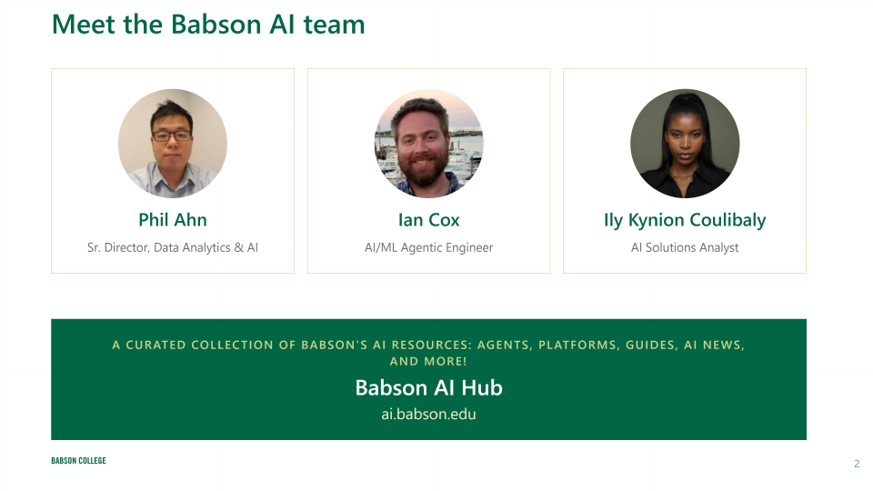

Slide 3
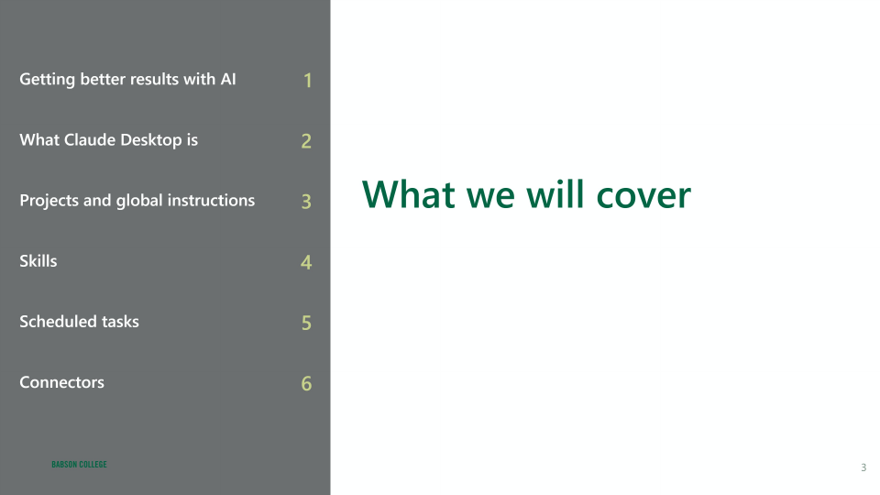

Slide 4
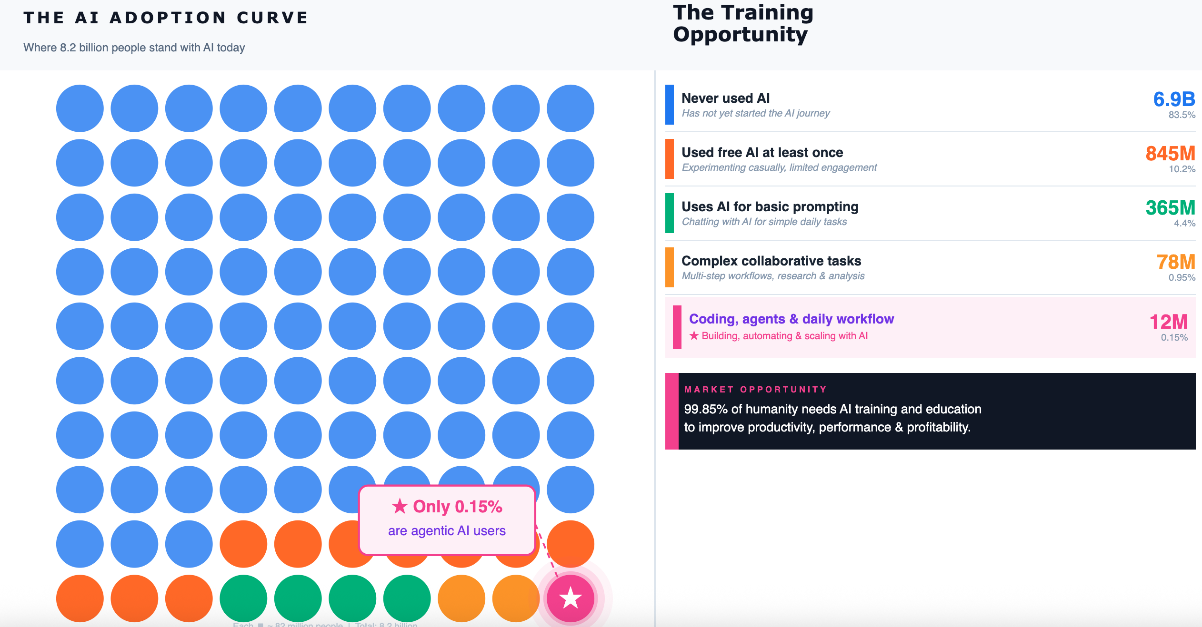

Slide 5
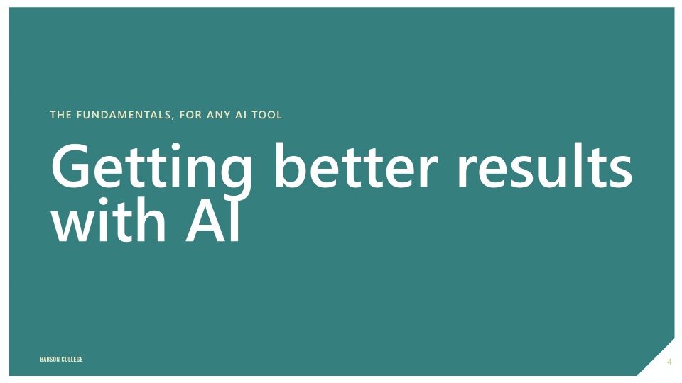

Slide 6
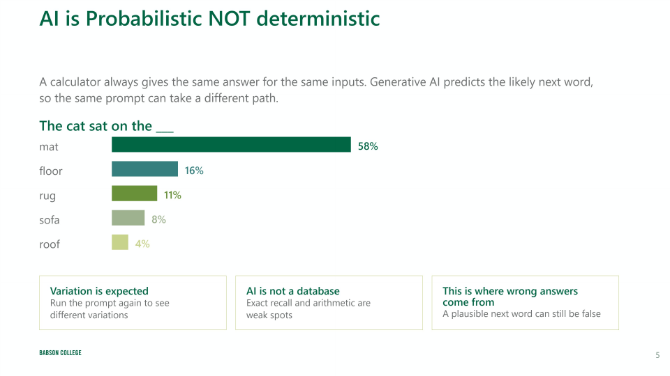

Slide 7
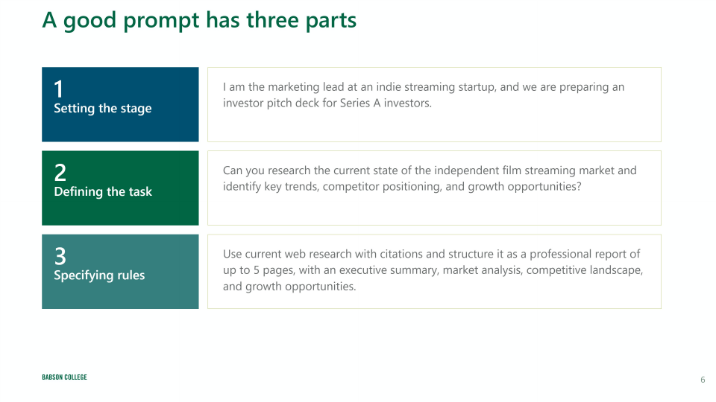

Slide 8
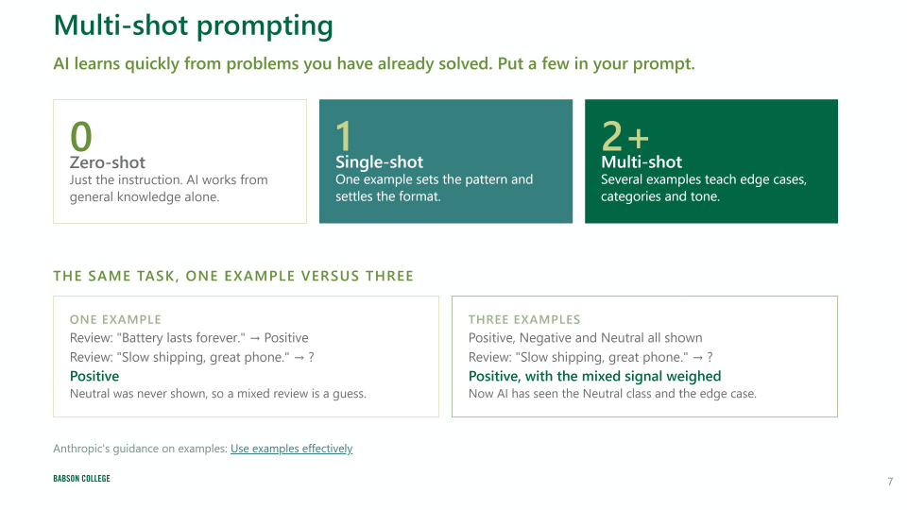

Slide 9
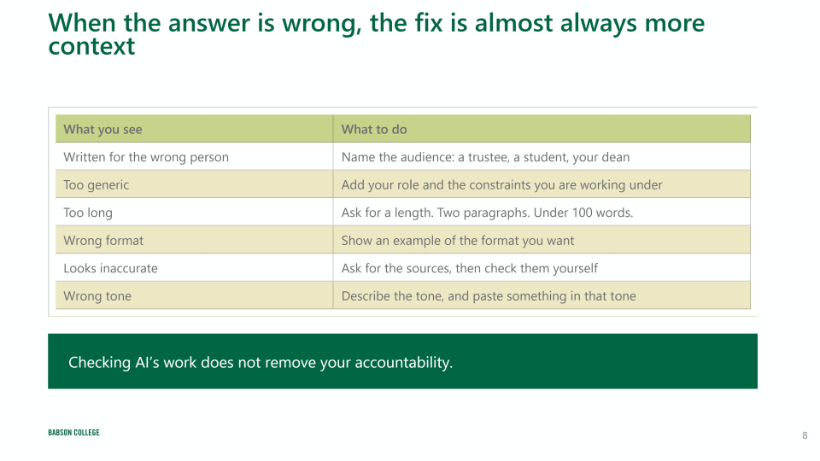

Slide 10
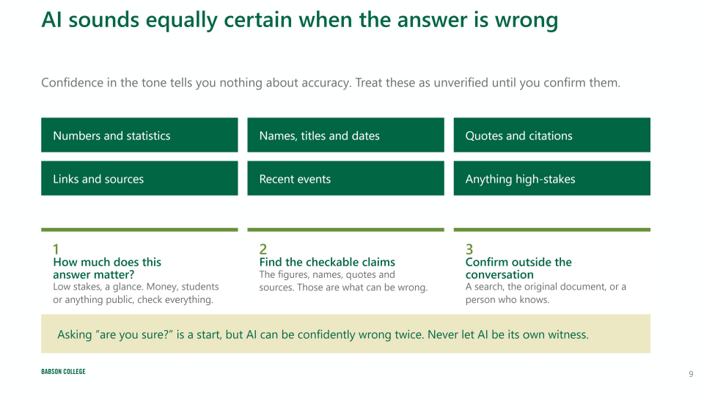

Slide 11

CLAUDE DESKTOP
AI safety and leadership values
A short reflection on responsibility, judgment, and the human role in AI-enabled work.
WATCH & DISCUSS
0:50
Use this clip as a pause point. Ask what the example changes about how we delegate work, check results, and keep human judgment in the loop.
Local media embedded in the source deck

Slide 12
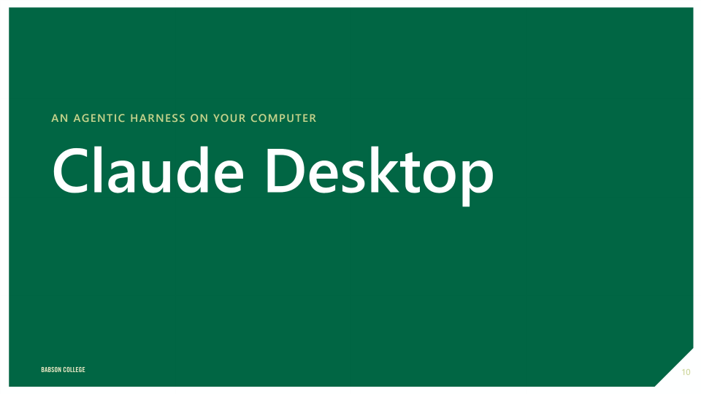

Slide 13
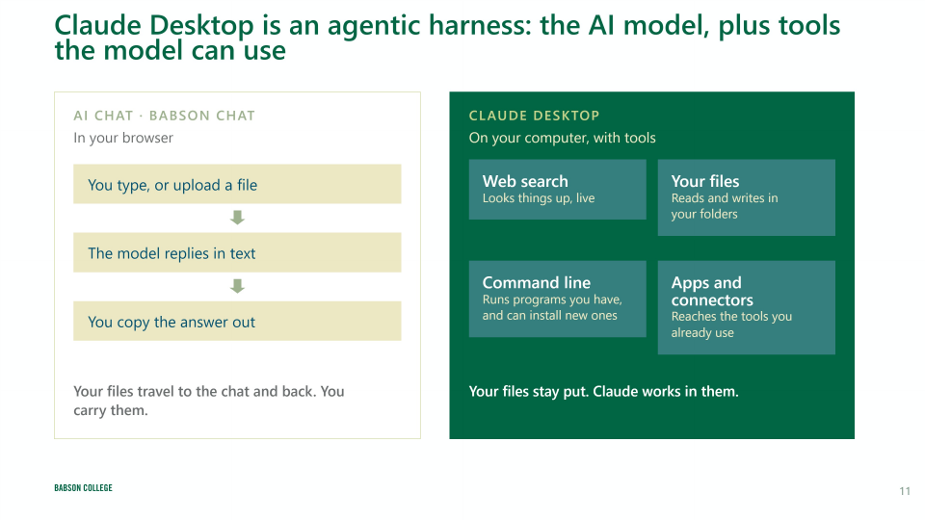

Slide 14
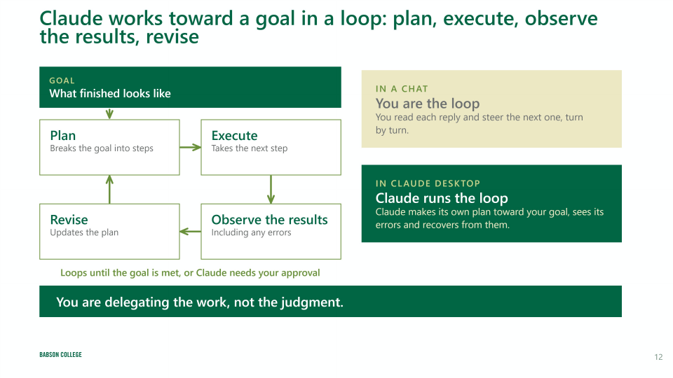

Slide 15
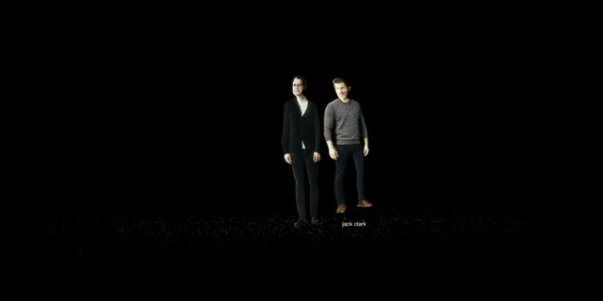
CLAUDE DESKTOP
Importance of AI alignment
Learning to cheat makes the alignment problem concrete: capable systems still need clear goals and boundaries.
WATCH & DISCUSS
0:47
Use this clip as a pause point. Ask what the example changes about how we delegate work, check results, and keep human judgment in the loop.
Local media embedded in the source deck

Slide 16
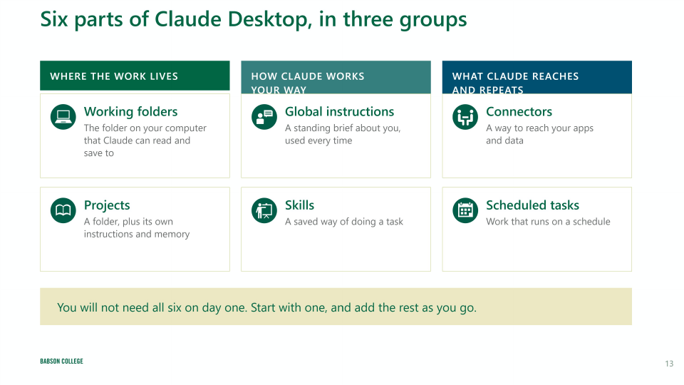

Slide 17


Slide 18
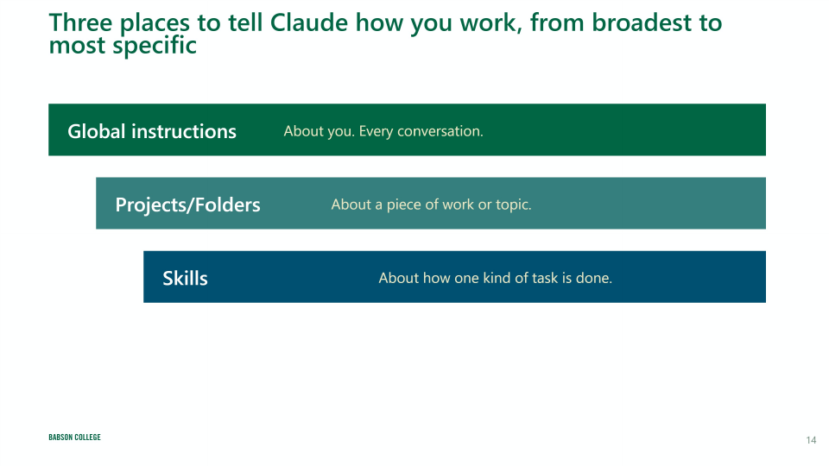

Slide 19
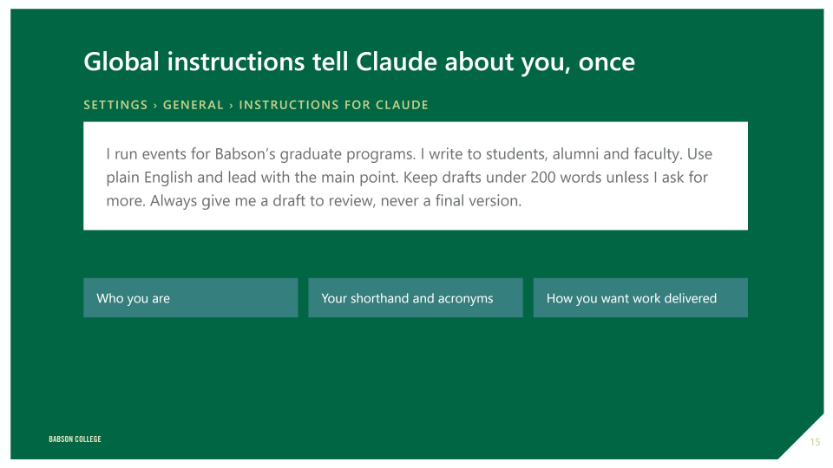

Slide 20
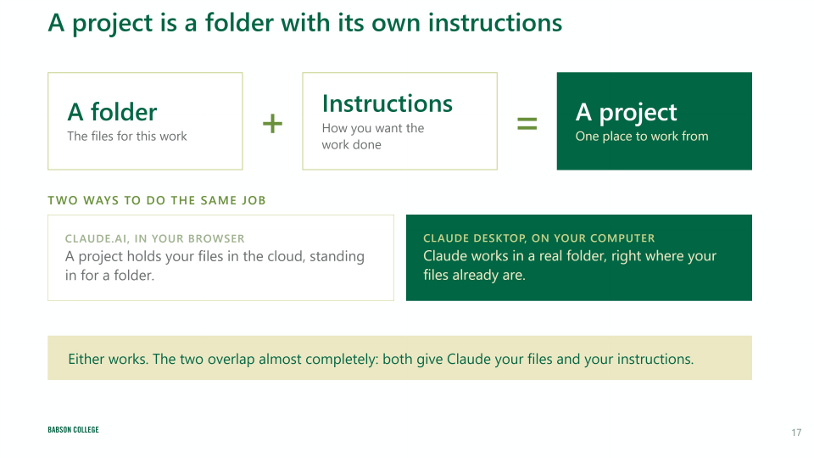

Slide 21
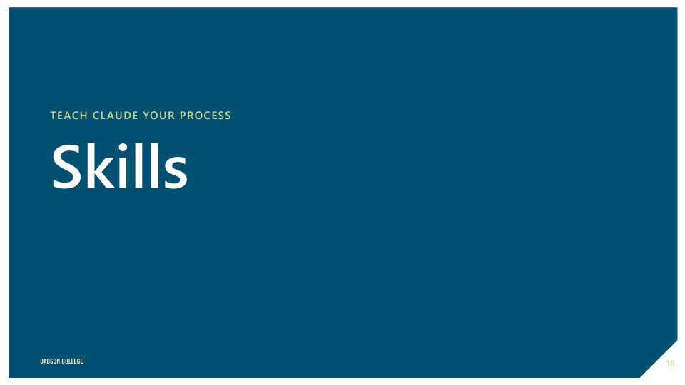

Slide 22
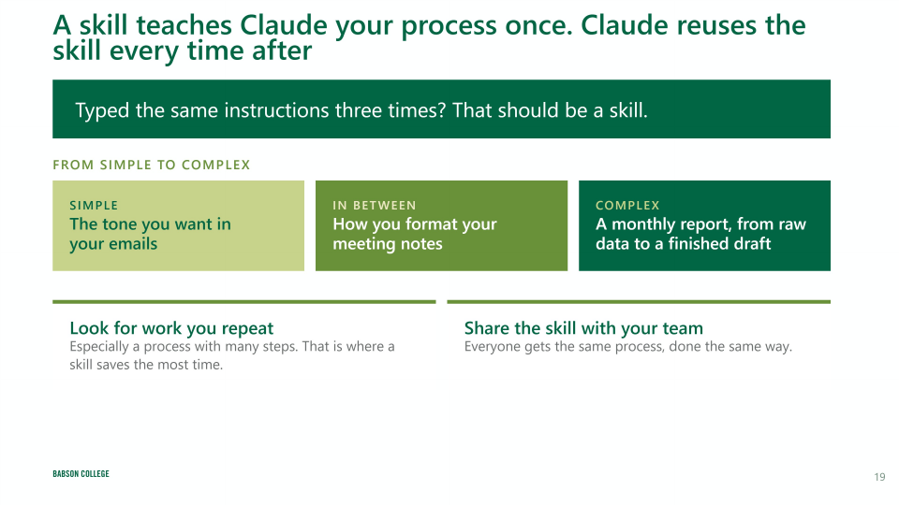

Slide 23
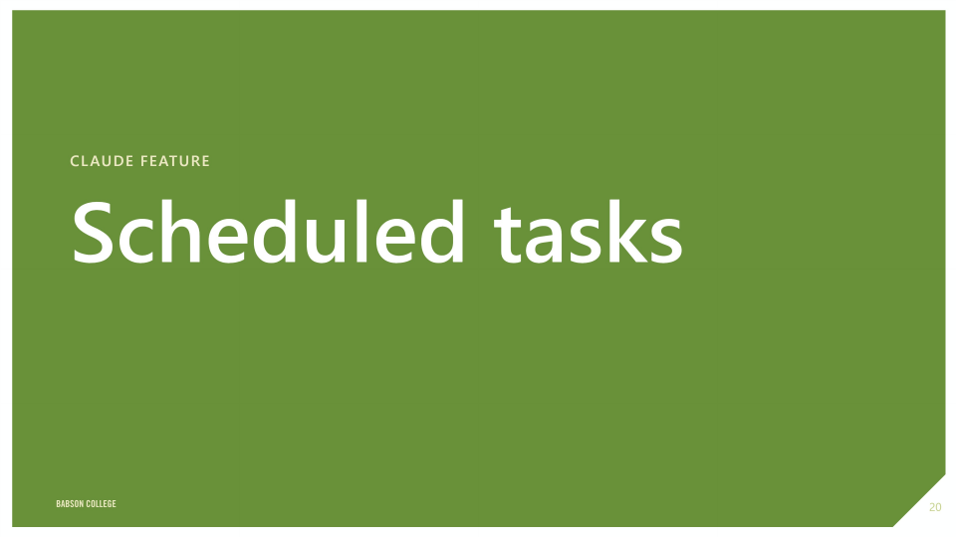

Slide 24
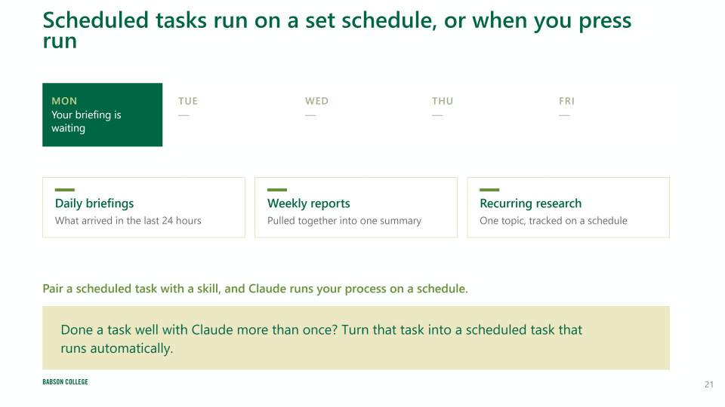

Slide 25


Slide 26
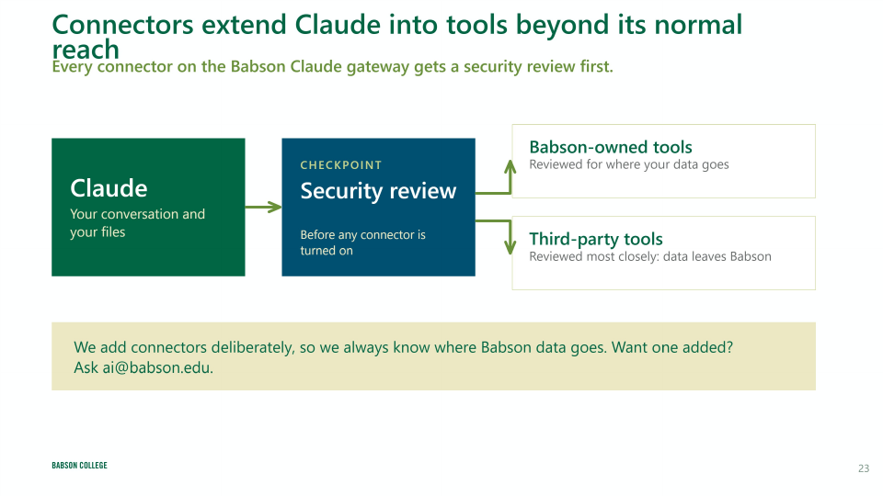

Slide 27
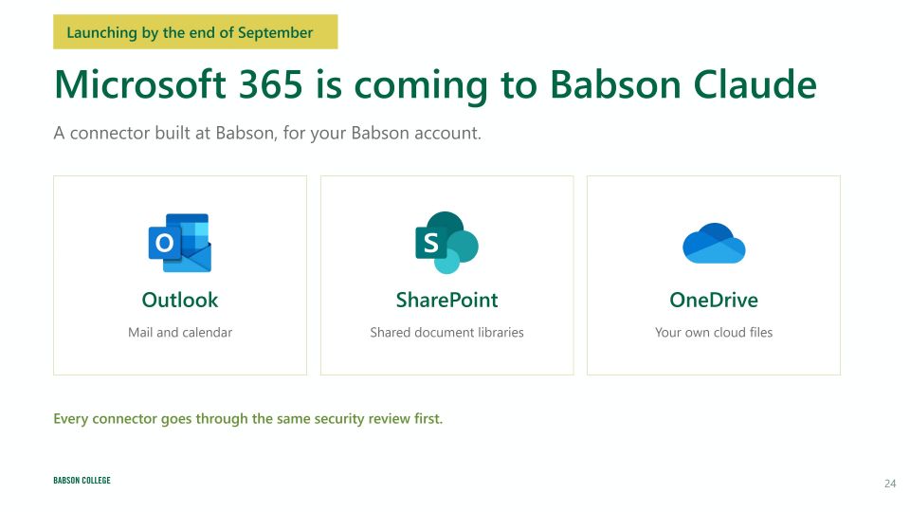

Slide 28
